Slide 1
PC Maintenance: Preparing for A+ Certification
Chapter 10: Introduction to Disk Storage

Slide 2
Chapter 10 Objectives
Understand magnetic and optical storage
Explain cylinders, heads, tracks, and sectors
Understand low-level and high-level formatting
Explain principles of partitioning
Choose an appropriate file system for the OS to be installed

Slide 3
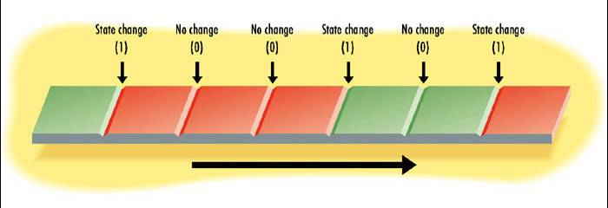
How Disks Store Data
Magnetic or optical
Based on transitions
  Electrical: positive or negative
  Optical: pit or land

Slide 4
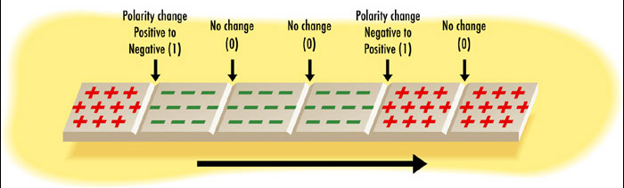
Magnetic Storage
Hard Disks, Floppy Disks
Polarity change between positive and negative

Slide 5
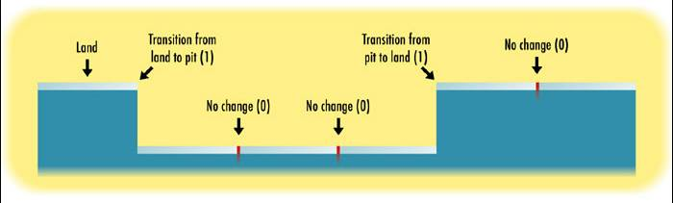
Optical Storage
CD, DVD
Change between pit (less reflective) and land (more reflective)

Slide 6
Disks Versus Drives
Disk: Platters that store data
Drive: Mechanism that spins and reads platters
Hard disk drive: integrated disk and drive
Floppy and CD: separate disk and drive

Slide 7
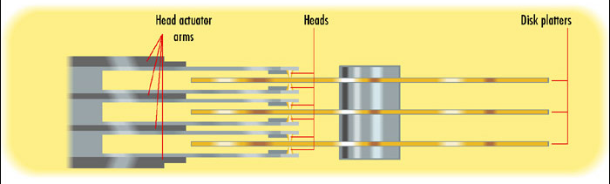
How Disk Space is Organized
Heads: Read-write mechanisms, one for each side of each disk platter

Slide 8
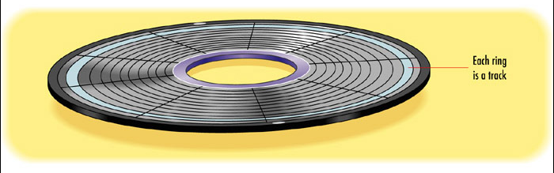
How Disk Space is Organized
Tracks: Concentric rings on a platter

Slide 9
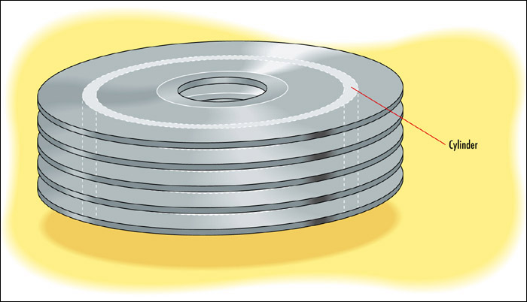
How Disk Space is Organized
Cylinders: The same track on a stack of platters and sides

Slide 10

How Disk Space is Organized
Sectors: Sections of a track created by radial lines from the center of the disk

Slide 11
Low-Level Formatting
Creates tracks and sectors
Defines the disk geometry
Done at the factory

Slide 12
Zoned Recording and Sector Translation
Zoned Recording: Fewer sectors in center of disk than at outer rings
Sector Translation: Conversion between physical sectors and logical ones needed to interface with PC

Slide 13
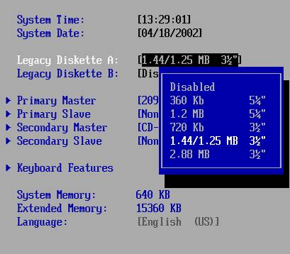
Floppy Drive BIOS Support
Not Plug and Play

Slide 14
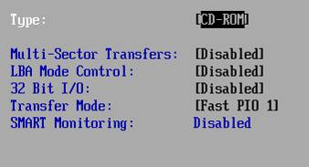
CD-ROM Drive BIOS Support
Auto (Recommended)
CD-ROM
ATAPI Removable
IDE Removable

Slide 15
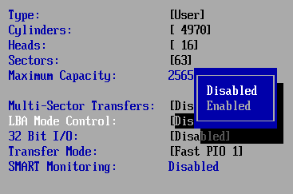
BIOS Translation Methods
Standard CHS: Cylinders, Heads, Sectors
Extended CHS (ECHS, also called Large)
Logical Block Addressing LBA

Slide 16
Enhanced BIOS Services for Disk Drives
A BIOS feature, not a drive feature
Released in 1998
Gives the BIOS the capability to recognize large drive sizes (over 8.4 GB)
Primary reason why very old PCs cannot see large new drives
Requires a BIOS update for motherboard or add-on BIOS utility from drive maker

Slide 17
Data Transfer Modes
DMA: Direct Memory Addressing
  Regular and bus mastering
PIO: Programmed Input/Output
  PIO modes 0 through 4
UltraDMA (Ultra ATA)
  Modern standard for drive interfaces
  Makes regular DMA and PIO obsolete
  Much faster (33MB/sec to over 150MB/sec)

Slide 18
Disk Partitions
Physical drive can be divided up
  Primary partition
  Extended partition
Each partition can have one or more logical drives
  Primary partition can have only one drive letter
  Extended partition can have multiple drive letters

Slide 19
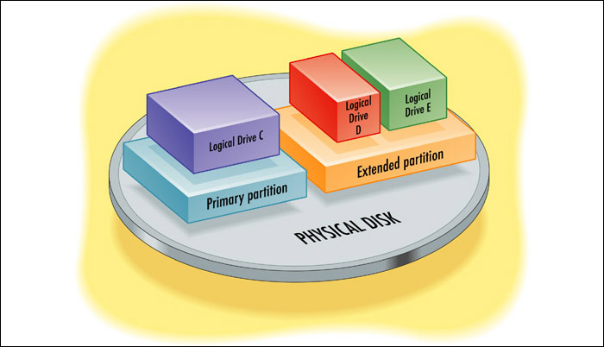
Disk Partitions

Slide 20
Active Partition
Bootable partition
Only one can be active
Must be a primary partition

Slide 21
Master Boot Record
Contains information about the physical drive’s partitions
Written to the first sector of the first cylinder of the first head
Persists no matter what high-level formatting is done to the drive

Slide 22
Clusters
Groups of sectors that are addressed as a group
Makes storage access quicker since there are fewer units to address
Allows larger drives to be addressed
Wastes some space when cluster is not completely full
Larger clusters are more wasteful

Slide 23
Default Cluster Sizes
Each file system has its own default cluster size rules (FAT16, FAT32, NTFS)
Cluster size can vary from 1 to 64 sectors
Generally, smaller drive has smaller cluster size
Refer to Tables 10.1, 10.2, and 10.3 in textbook

Slide 24
Common File Systems
FAT16
FAT32
NTFS 4
NTFS 5

Slide 25
FAT Formatting
Creates the volume boot record:
  Every logical drive has one
  Holds information about the partition
  Stores the boot files if a bootable drive
  Written to the first sector of the logical disk (the boot sector)
  At startup, OS looks to the boot sector to see if it contains startup files

Slide 26
FAT Formatting
Creates the File Allocation Table
  Small database
  Two copies of it, for redundancy
  Tracks only the first cluster of each file
  Tracks only files and folders in the root directory

Slide 27
FAT Formatting
Reads information from low-level format about physical defects to avoid in disk surface
Creates the root directory
  Top-level folder
  All others are placed here

Slide 28
FAT16 versus FAT32
FAT16
  Original FAT file system
  Uses 16-bit binary numbers to identify each cluster
FAT32
  Improved version
  Uses 32-bit binary numbers to identify each cluster
  Drive sizes can be larger because there are more numbers available for cluster IDs

Slide 29
OS Compatibility of FAT
FAT16:
  All MS-DOS and Windows versions
FAT32:
  No support in MS-DOS, Windows NT 4.0, or Windows 95
  Windows 95C provides limited support (no conversion utility)
  Windows 98 and higher provide full support

Slide 30
NTFS
New Technology File System
Developed for Windows NT (NTFS 4)
Improved for Windows 2000 and higher (NTFS 5)
32-bit file system
More sophisticated security permissions
Encryption (NTFS 5)

Slide 31
NTFS Features
Volume Boot Record
  Equivalent to Volume Boot Record in FAT32
Master File Table
  Equivalent to File Allocation Table
System Files
  No stand-alone command interpreter
  User interface separate from OS kernel

Slide 32
OS Compatibility of NTFS
No support in MS-DOS or 9x versions of Windows
NTFS 4 supported in Windows NT 4.0
NTFS 5 supported in Windows 2000 and XP
Conversion done automatically when upgrading from NT 4.0 to 2000 or XP

